Slide 1
mpalomar@stanford.edu
carlosq@stanford.edu
mwhardt@stanford.edu
Video Links
https://youtu.be/7QhV2R64oDM
https://github.com/txoritxo/cs231a_Project/blob/main/presentation/cs231a_project_full.mp4

Slide 2
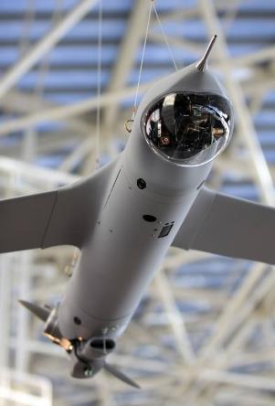
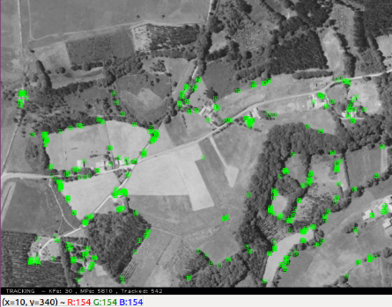
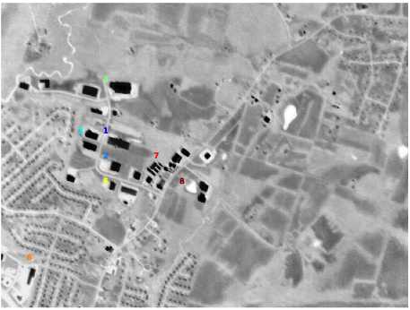

Problem Statement
mpalomar@stanford.edu
carlosq@stanford.edu
mwhardt@stanford.edu
UAVs need to be able to navigate with onboard cameras.
Temperature fluctuations, vibrations, zoom functionalities, etc. all can make a laboratory calibration invalid
Accurate navigation is very sensitive to a good calibration though.
Autocalibration in flight is a solution, yet at altitude, scene is mostly planar, making traditional methods inapplicable
Need to take advantage of the scene structure!
[Triggs ’98] first presented a method specifically dedicated to planar scenes based upon inter-image homographies

Slide 3
Technical Approach
mpalomar@stanford.edu
carlosq@stanford.edu
mwhardt@stanford.edu
“Forget the checkerboard: practical self-calibration using a planar scene”
Herrera et. Al, WACV 2016
Asm.
Assumptions
Planar scene
Camera
zero-skew
Radial distortion model
Step 1
Feature Extraction
& Matching
SIFT feature extraction
FLANN matching
Filtering
Step 2
Projective
Reconstruction
Homography estimation
RANSAC
Step 3
Projective
Bundle Adjustment
Initial estimation of distortion and Central Point
Refinement of Homographies and world coordinates of scene points

Slide 4
Technical Approach
mpalomar@stanford.edu
carlosq@stanford.edu
mwhardt@stanford.edu
Step 4
Homography based
Self-Calibration
Focal length estimation
Non-linear minimization
Principal point correction
Step 5
Metric Reconstruction
Initial extrinsic guess for reference frame
Approximate 3D point coordinates in reference frame (triangulation)
Extrinsic parameters for all frames using PnP
Step 6
Metric
Bundle Adjustment
Minimization of reprojection errors
Refine 3D scene point coordinates
Refine intrinsics and distortion

Slide 5
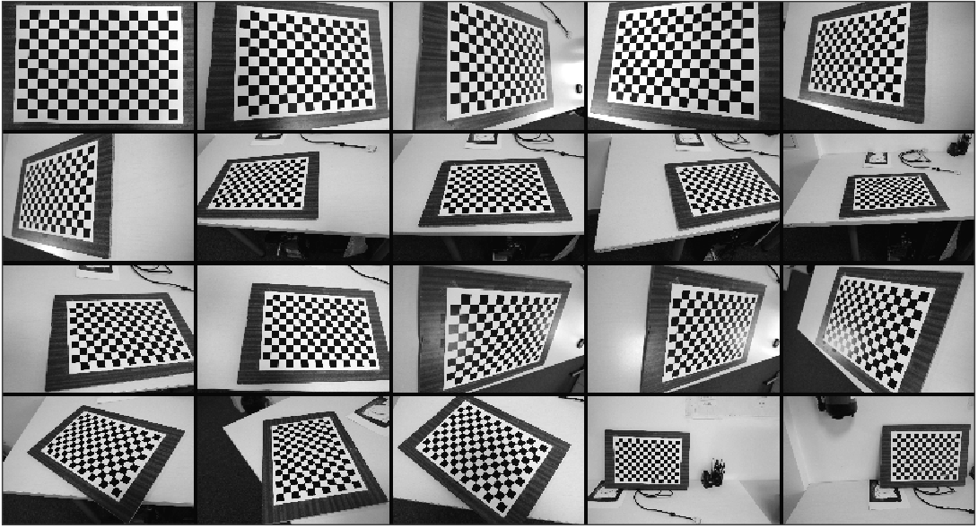
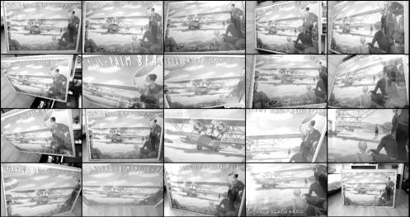
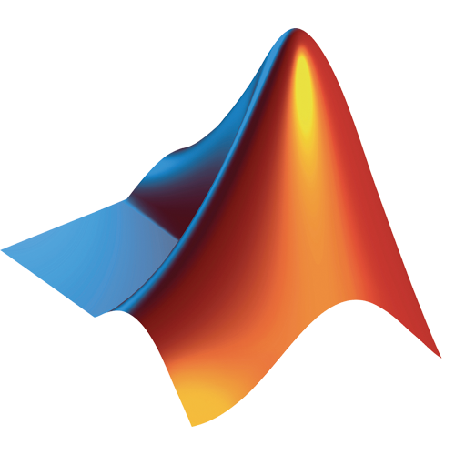

Results – Close Range Imagery
mpalomar@stanford.edu
carlosq@stanford.edu
mwhardt@stanford.edu
Baseline calibration
DSLR + 18mm lenses
Resized to 800x533 px
Baseline: Checkerboard calibration
Planar self-calibration: Poster Pictures
Custom Python implementation
Results
Matlab Calibration Toolbox
Custom planar self calibration method
Focal Length very accurate ~ 1.2%
Less accurate Principal point ~ 2.5–6 %
 |  | Checkerboard Cal. | Planar Self-Cal. | Deviation( %)
Focal Length | fx | 657.611 (18.25 mm) | 664.954 (18.45 mm) | 1.12
 | fy | 658.268 (18.27 mm) | 666.036 (18.49 mm) | 1.18
Principal Point | u | 401.66 | 425.684 | 5.98
 | v | 289.896 | 283.173 | 2.32
Distortion | d0 | -1.76E-01 | 3.75E-07 | 100.00
 | d1 | 1.04E-01 | 3.96E-13 | 100.00
Pixel Error |  | 0.65 | 0.58 | 10.28
Reprojection error slightly better than Checkerboard
High error in distortion, probably due to different Distortion models

Slide 6
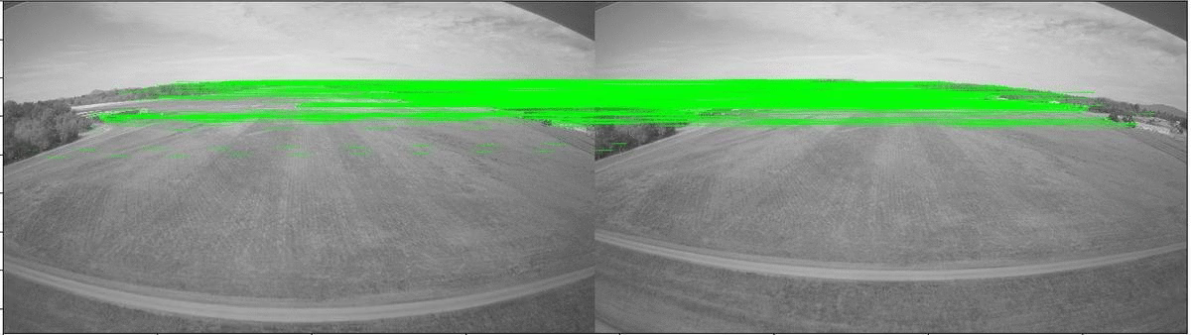
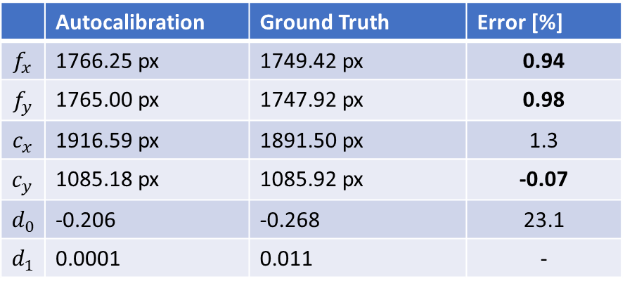
Results on real aerial imagery
mpalomar@stanford.edu
carlosq@stanford.edu
mwhardt@stanford.edu
 | Autocalibration | Ground Truth | Error [%]
$$f_{x}$$ | 1766.25 px | 1749.42 px | 0.94
$$f_{y}$$ | 1765.00 px | 1747.92 px | 0.98
$$c_{x}$$ | 1916.59 px | 1891.50 px | 1.3
$$c_{y}$$ | 1085.18 px | 1085.92 px | -0.07
$$d_{0}$$ | -0.206 | -0.268 | 23.1
$$d_{1}$$ | 0.0001 | 0.011 | -
Real flight imagery from landing maneuver at Sanderson Field Airport (Washington).
4K resolution images taken with GoPro camera (forward-looking).
Real lenses with radial + tangential distortion.

Slide 7

Results – Satellite Imagery
mpalomar@stanford.edu
carlosq@stanford.edu
mwhardt@stanford.edu
osgEarth is used to transform satellite orthoimagery to a given virtual camera perspective
 |  | Specified Cal. | Planar Self-Cal. | Deviation( %)
Focal Length | fx | 1117.65 | 1527.25 | 36.7
 | fy | 1117.65 | 1455.30 | 30.3
Principal Point | u | 511.5 | 480.65 | 6.0
 | v | 383.5 | 415.15 | 8.3
Distortion | d0 | 0 | -3.29E-09 | -
 | d1 | 0 | -1.2515E-14 | -
Pixel Error |  | N/A | 0.07 | -
Poor results
Large estimation errors even though plane is performing roll maneuver in sample images, i.e. rotation + translation.
Measures to improve numerical conditioning for optimization:
normalized feature points, program Jacobians for bundle adjustments, select homographies with best condition numbers

Slide 8
Conclusions
mpalomar@stanford.edu
carlosq@stanford.edu
mwhardt@stanford.edu
[Herrera ’16] Autocalibration fully implemented in Python
Close-range imagery results: Promising results with checkerboard in comparison with standard methods. Distortion model fitting plays important role.
Runway imagery results: Very promising results with real flight imagery in special landing case. Good use case!
High altitude imagery results: Suspect too close to degenerate case of pure translation between views of planar imagery.
Real flight imagery with perpendicular view
Need to further take advantage of the scene structure to get yet better results for this application.
[Yang ’19] presented a method specifically dedicated to autocalibrate planar scenes with pure translational movement

